Slide 1




Tharaka University College Pedagogy Workshop 16th February 2022 ICT & UNIVERSITY TEACHING II Kevin Tuei Coordinator, Open Distance & eLearning Tharaka University College https://linkedin.com/in/kevintuei +254712838653

Slide 2
SESSION OVERVIEW
Presentation – 25 Minutes
Demo & Practicals – 55 Minutes
Way Forward – 10 Minutes

Slide 3
Why ICT-Pedagogy Integration?
The UNESCO ICT Competency Framework for Teachers (p. 21) states that:
The successful integration of ICT into the learning environment will depend on the ability of teachers to structure learning in new ways, to merge technology appropriately with a pedagogy, develop socially active classrooms, and encourage co-operative interaction and collaborative learning and group work. For many, this requires a different set of skills from those they currently possess.

Slide 4
Why ICT-Pedagogy Integration?
The effective integration of ICT alongside the curriculum is associated with a new pedagogy which redefines the role of the teachers and increases learners’ control of their learning, self-regulation, and collaboration.

Slide 5
How is ICT used in education at TUC?
ICT has also become integral to the teaching-learning interaction, through such approaches as
Replacing whiteboards with interactive digital whiteboards
TUC has acquired two interactive digital boards available at the Learning Resource Centre and Comp Lab 2
Flipped classroom model where students watch lectures at home on the computer and use classroom time for more interactive exercises
TUC has committed Ksh. 1 Million towards innovation in the FY 2021/22 and will host a career and innovation week in March 2022.

Slide 6
How is ICT used in education at TUC? (Cont’d)
E-readers are electronic devices that can hold hundreds of books in digital form, and they are increasingly utilized in the delivery of reading material
TUC has developed and customized the E-learning mobile app making it possible for students to download notes for offline access.
Online digital repositories for lectures, course materials, and digital library,
TUC has an institutional repository for all e-materials and Moodle
Electronic textbooks, instructional software, email, chat, and distance learning programs are also examples of ICT.
TUC has MyLOFT for all electronic resources

Slide 7
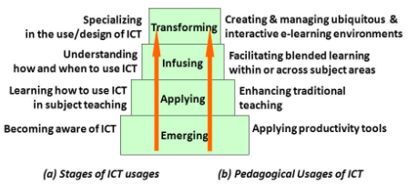
Stages of Teachers’ Development in ICT – Pedagogy integration

Slide 8
Frameworks for Technology Integration in Pedagogy
Two commonly used models for technology integration are
TPACK (Technological Pedagogical Content Knowledge) framework
SAMR (Substitution, Augmentation, Modification, Redefinition) model

Slide 9
Technological Pedagogical Content Knowledge (TPACK)
TPACK is a framework for understanding and describing the knowledge needed by a teacher for effective ICT integration.
The TPACK framework argues that effective ICT integration for teaching specific content or subject matter requires understanding of the relationships among three components:
ICT/Technology (T),
Pedagogy (P),
Content (C) in a certain context.
TPACK can be defined as an understanding that emerges from the interaction of Content, Pedagogical, and
Technological Knowledge

Slide 10
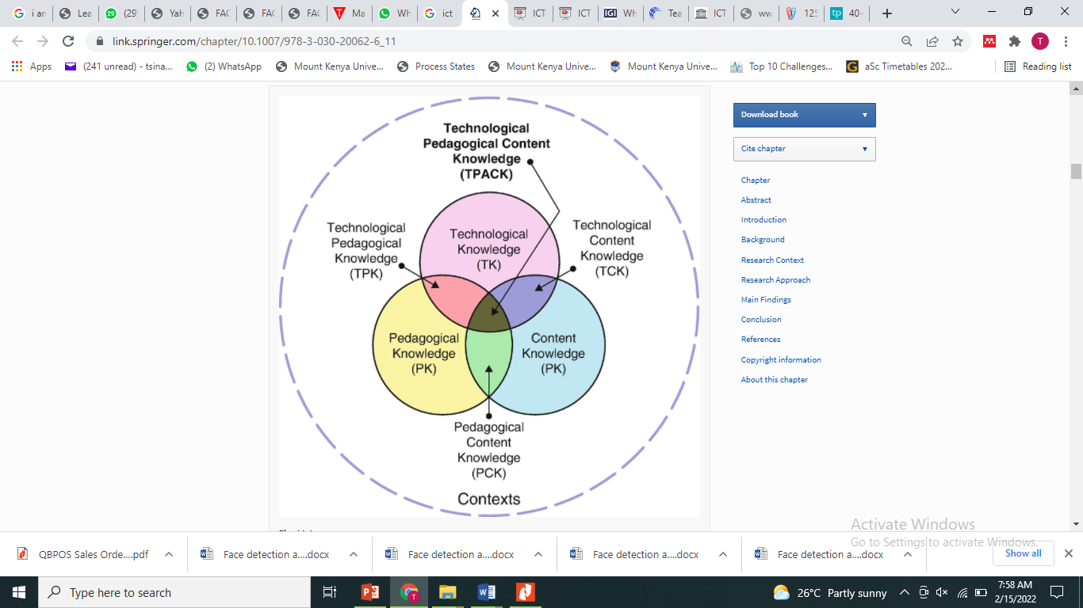
Technological Pedagogical Content Knowledge (TPACK) (Cont’d)

Slide 11
Substitution, Augmentation, Modification, Redefinition (SAMR ) model
This model was created by Dr. Ruben Puentudura, guides the process of reflecting on how we are integrating technology into our classrooms.
The ultimate goal of technology integration is to completely redefine how we teach and learn, and to do things that we never could before the technology was in our hands.

Slide 12
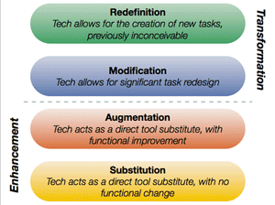
Substitution, Augmentation, Modification, Redefinition (SAMR ) model (Cont’d)

Slide 13
INTEGRATED ICT TOOLS
Video Conferencing Platforms (Google Meet, Zoom, Ms-Teams, Webex, KENET)
Websites/Blogs/LMS
Web based learning (Video Lectures, Virtual Simulations)
Portable Devices(Smartphones, Tablets, Laptops)
Online Assessment Proctoring Tools (SEB, Pearson VUE, ProctorU)
Smart boards/Interactive Display Panels (Smart, Clevertouch)
Multi-media equipment(Learning Resource Centre)
Digital cameras/Video Cameras (Learning Resource Centre)
Broadcast/Discussion platforms/Communities of Practice
(Whatsapp, Facebook, LinkedIn )
10) Assistive Technologies and Devices e.g. hearing devices, large font

Slide 14
Types of Technology Integration
Online Learning and Blended Classrooms
Project-Based Activities Incorporating Technology
Game-Based Learning and Assessment
Learning with Mobile and Handheld Devices
Instructional Tools like Interactive Whiteboards and Student Response Systems
Web-Based Projects, Explorations, and Research
Student-Created Media like Podcasts, Videos, or Slideshows
Collaborative Online Tools like Wikis or Google Docs, Confluence
Using Social Media to Engage Students

Slide 15
New technologies in Teaching and Learning Processes
eLearning – Virtual Learning Environments (VLEs)
Video-Assisted Learning
Immersive Learning With Virtual Reality and Augmented Reality
Blockchain Technology
Big Data
Artificial Intelligence (AI)
Social Media In Learning
Learning Analytics
Gamification
Science, Technology, Engineering and Mathematics - driving innovation in teaching and learning

Slide 16
Conclusion
ICT in education improves engagement and knowledge retention: When ICT is integrated into lessons, students become more engaged in their work. This is because technology provides different opportunities to make it more fun and enjoyable in terms of teaching the same things in different ways.
ICT can lead to improve students' learning as well as better pedagogical practices
Use ICT to improve true value of in learning, inspiring learners, and making education more relevant and empowering

Slide 17
DEMO & PRACTICALS
Logging into the LMS
Accessing the pre-created courses in the LMS
Embedding teaching materials, Video Conferencing Links and Discussion Forums in the LMS
Adding students to a course in the LMS
Monitoring student progress and creating assessments in the LMS
Understanding the existing restrictions and creating restrictions in the LMS
Applying ICT tools (Web Captioner, OER, Mathtype, Simulations)
Accessing the institutional repository and MyLOFT

Slide 18
WAY FORWARD
Enroll and complete “ICT Integration in Teaching and Learning” https://www.open.edu/openlearncreate/mod/oucontent/view.php?id=142559 – Date ?
Avail digital notes for all units taught each semester on the University LMS – Date ?
Liaise with Departmental ODeL Coordinators in continual development of ODeL Modules – Date ?
Avail all publications for upload in the institutional repository – Date ?
Develop a personal action plan for integrating ICT into your teaching and learning – Date ?

